Slide 1

Microsoft Fabric for Dummies
Koen Verbeeck – He/him

Slide 2







contact
Koen Verbeeck
@Ko_Ver
@koenv.bsky.social
SQLkover.com

Slide 3
what is Microsoft Fabric?

Slide 4
I am the Chief Data Officer and don’t want to be the Chief Integration Officer
Every CDO in every enterprise

Slide 5
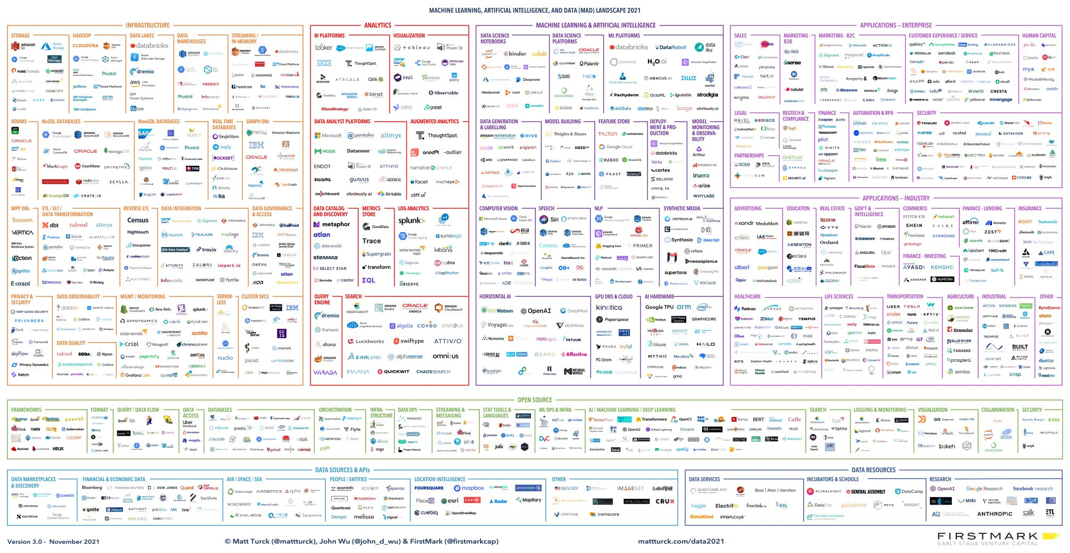
the modern data stack

Slide 6






Microsoft Fabric
Data Integration
Data Lake
Spark Engines
Data
Warehouse
Real Time Analytics
Data
Science
Business
Intelligence
Governance
Unified analytics fabric
End-to-end analytics data fabric
From the data lake to the business user

Slide 7
Microsoft Fabric
Single…
Data
Integration
Data
Engineering
Data Warehousing
Real-
Time Analytics
Data Science
Business Intelligence
Onboarding and trials
Sign-on
Navigation model
UX model
Workspace organization
Collaboration experience
Data Lake
Storage format
Data copy for all engines
Security model
CI/CD
Monitoring hub
Data Hub
Governance & compliance
AI Assisted
Shared Workspaces
Universal Compute Capacities
OneSecurity
OneLake
SaaS foundation

Slide 8
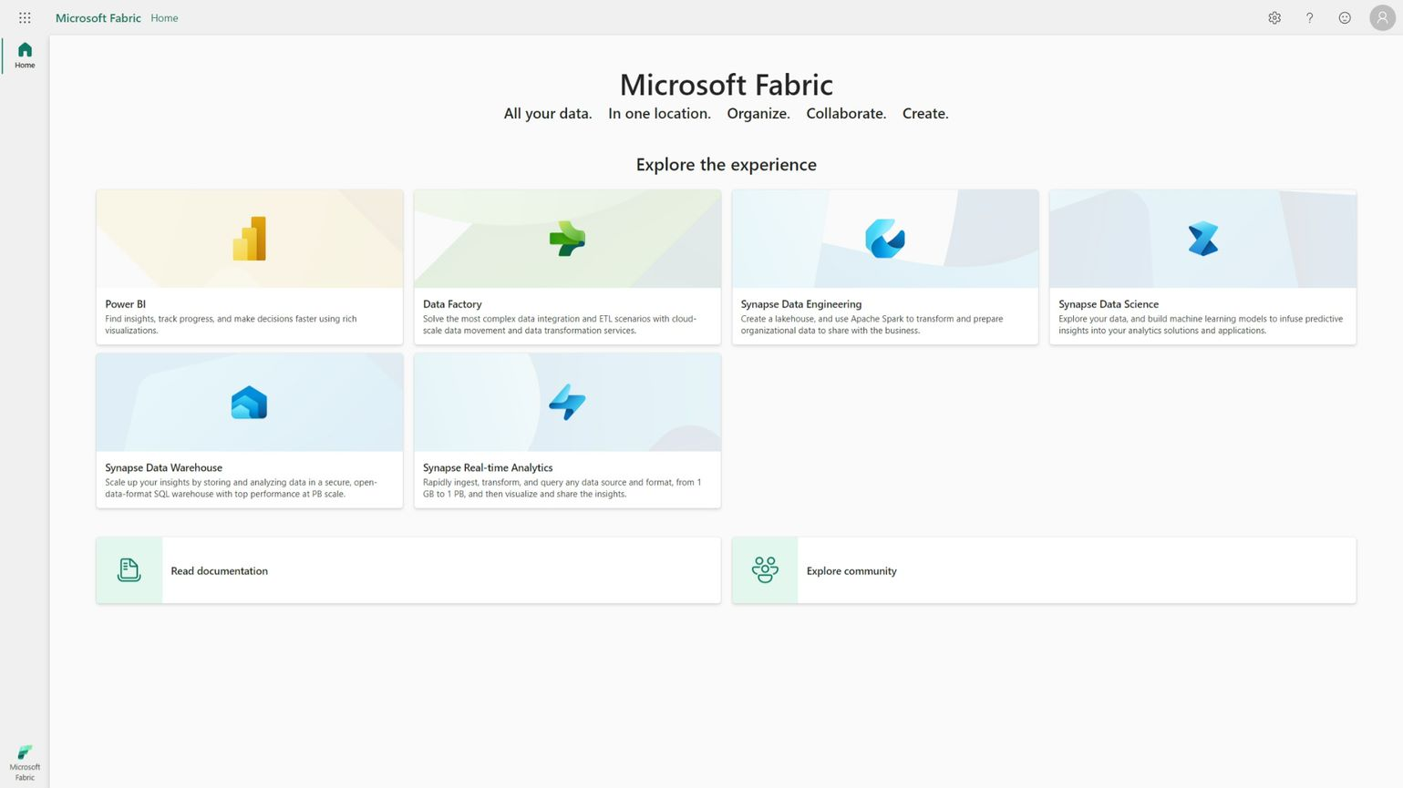
Persona Centric Experiences

Slide 9
… and everything will get Copilot

Slide 10
data storage

Slide 11
it’s all Delta
(Parquet)

Slide 12
OneLake for all Data
“The OneDrive for Data”
Data
Warehousing
Data
Engineering
Data Integration
Data
Science
Real
Time
Analytics
Business Intelligence
A single SaaS lake for the whole organization
Provisioned automatically with the tenant
All workloads automatically store their data in the OneLake workspace folders
All the data is organized in an intuitive hierarchical namespace
The data in OneLake is automatically indexed for discovery, MIP labels, lineage, PII scans, sharing, governance and compliance
OneLake Storage
Intelligent data fabric

Slide 13
One Copy for all computes
Real separation of compute and storage
Data
Warehousing
Data
Engineering
Data Integration
Data
Science
Real
Time
Analytics
Business Intelligence
All the compute engines store their data automatically in OneLake
The data is stored in a single common format
Delta – Parquet, an open standards format, is the storage format for all tabular data in Fabric
Once data is stored in the lake, it is directly accessible by all the engines without needing any import/export
All the compute engines have been fully optimized to work with Delta Parquet as their native format
Shared universal security model is enforced across all the engines
Serverless
Compute
T-SQL
Spark
KQL
Analysis Services
OneLake Storage
Finance
Customers 360
Service Telemetry
Business KPIs
Delta – Parquet Format
Delta – Parquet Format
Delta – Parquet Format
Delta – Parquet Format

Slide 14
One Copy for all computes
Universal security makes it real
Data
Warehousing
Data
Engineering
Data Integration
Data
Science
Real
Time
Analytics
Business Intelligence
All the compute engines store their data automatically in OneLake
The data is stored in a single common format
Delta – Parquet, an open standards format, is the storage format for all tabular data in Fabric
Once data is stored in the lake, it is directly accessible by all the engines without needing any import/export
All the compute engines have been fully optimized to work with Delta Parquet as their native format
Shared universal security model is enforced across all the engines
Serverless
Compute
T-SQL
Spark
KQL
Analysis Services
OneLake Storage
OneSecurity
Finance
Customers 360
Service Telemetry
Business KPIs
Delta – Parquet Format
Delta – Parquet Format
Delta – Parquet Format
Delta – Parquet Format

Slide 15



Taking One Copy to the next level
Shortcuts
Sharing data in OneLake is as easy as sharing files in OneDrive, removing the needs for data duplication
With shortcuts, data throughout OneLake can be composed together without any data movement
Shortcuts also allow instant linking of data already existing in Azure and in other clouds, without any data duplication and movement, making OneLake the first multi-cloud data lake
With support for industry standard APIs, OneLake data can be directly accessed by any application or service
Data
Integration
Data
Engineering
Data Warehousing
Real
Time Analytics
Data Science
Business Intelligence
OneLake Storage
Finance
Customers 360
Service Telemetry
Business KPIs
Azure
Amazon
Google

Slide 16

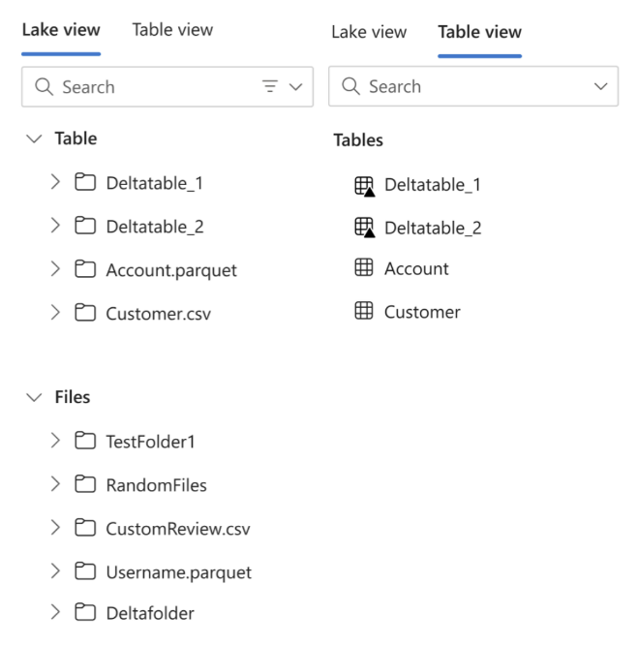
OneLake working with both files and tables

Slide 17
data engineering

Slide 18
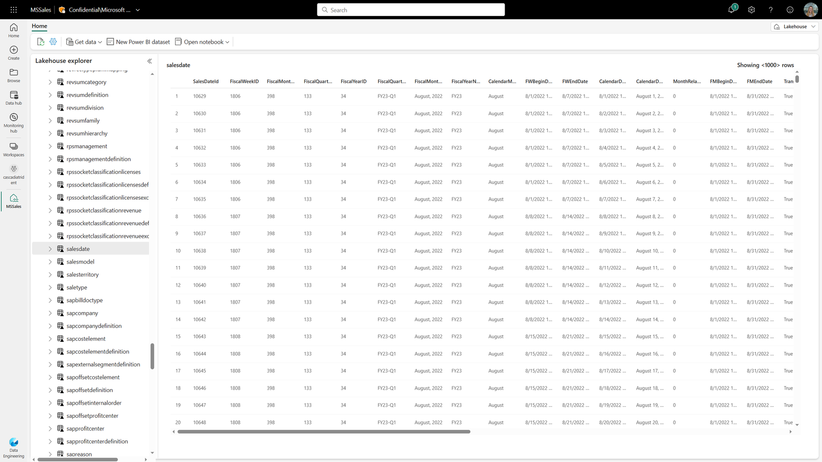
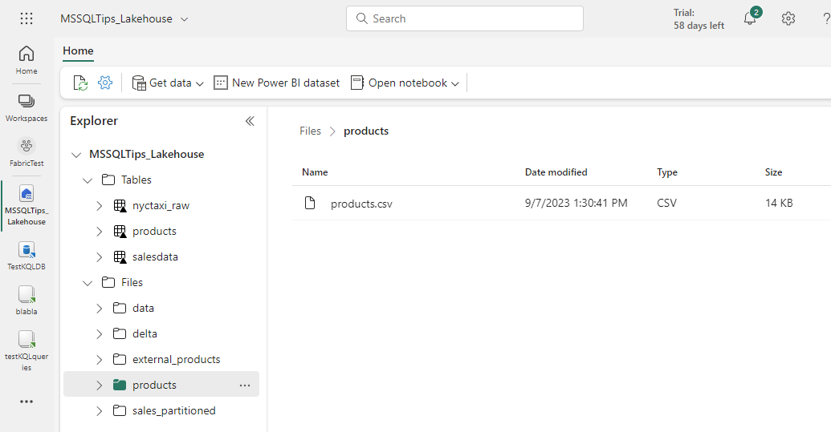
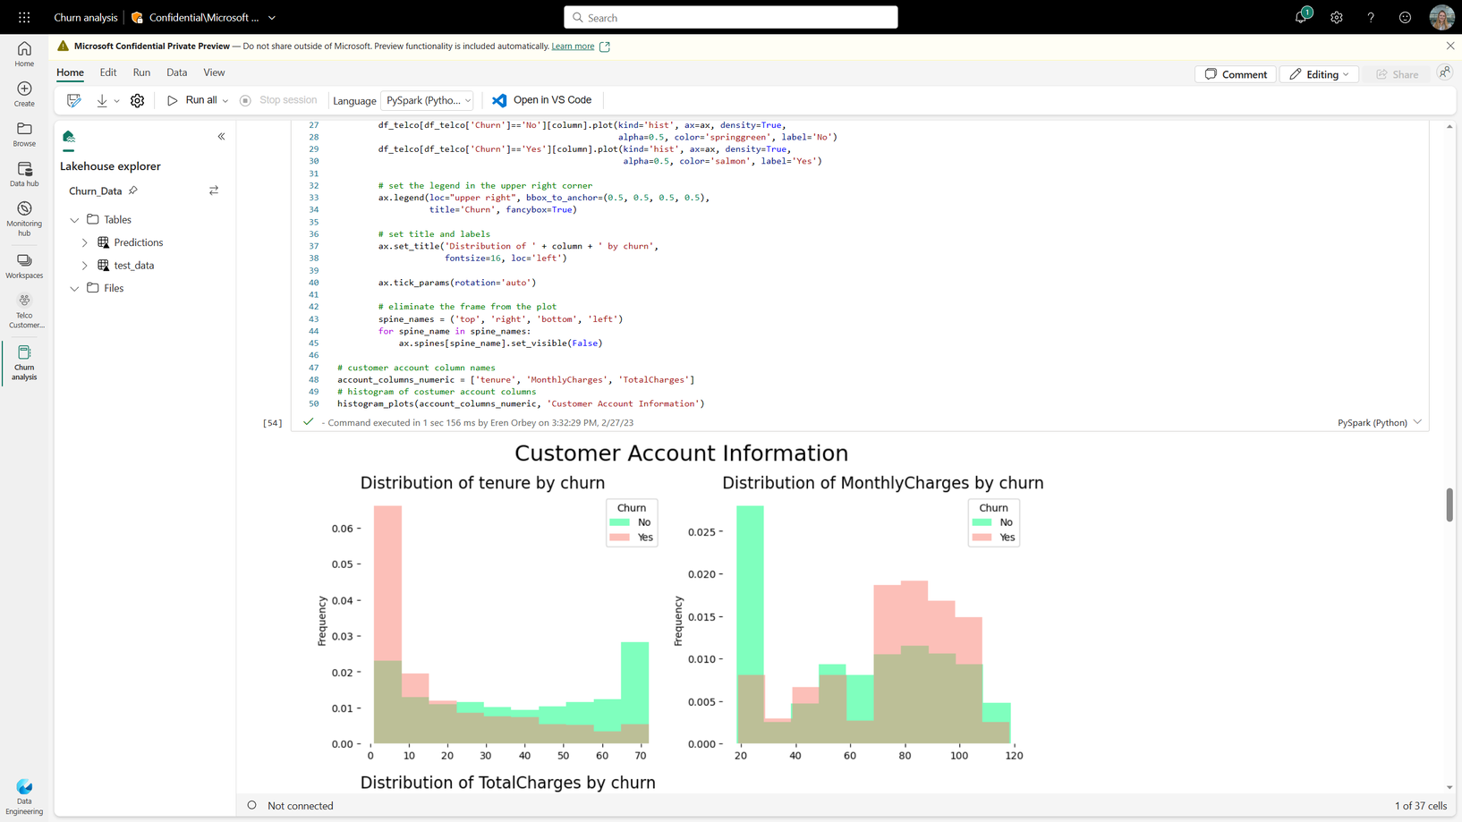
Data Engineering

Slide 19
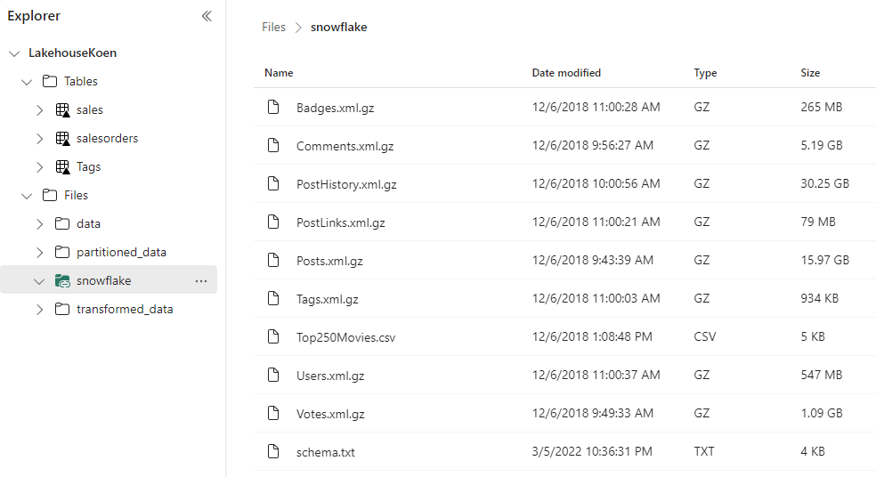
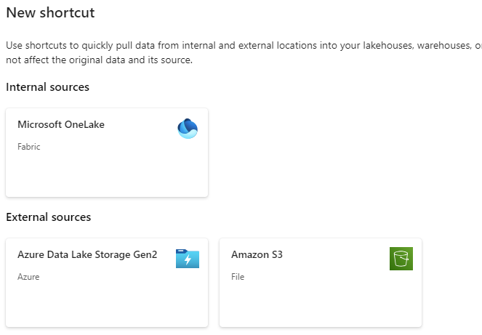


Shortcuts

Slide 20
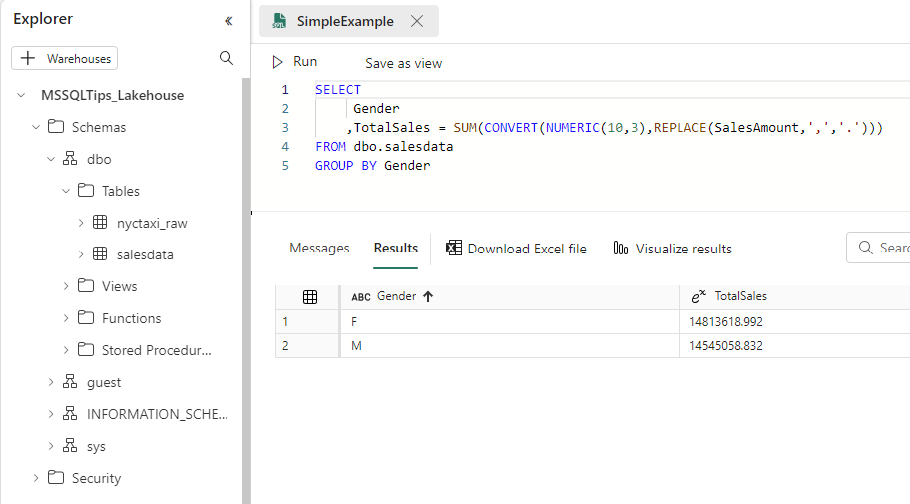
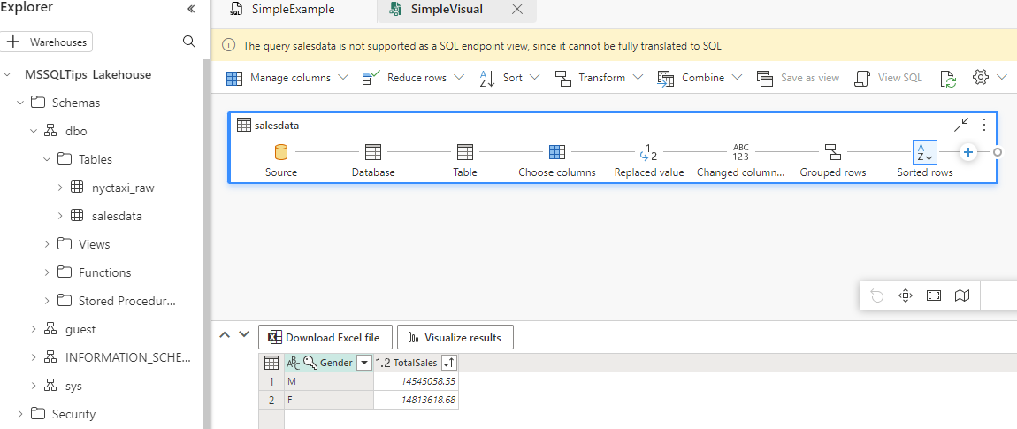
SQL Endpoint

Slide 21
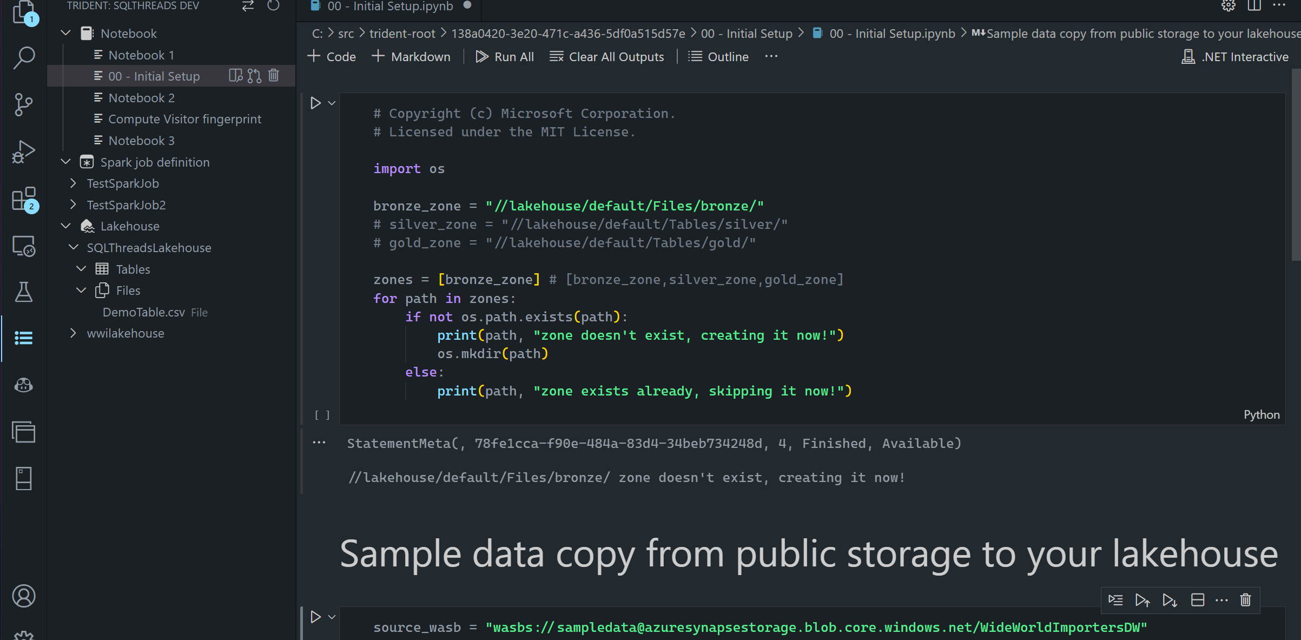
Notebooks in VS Code

Slide 22
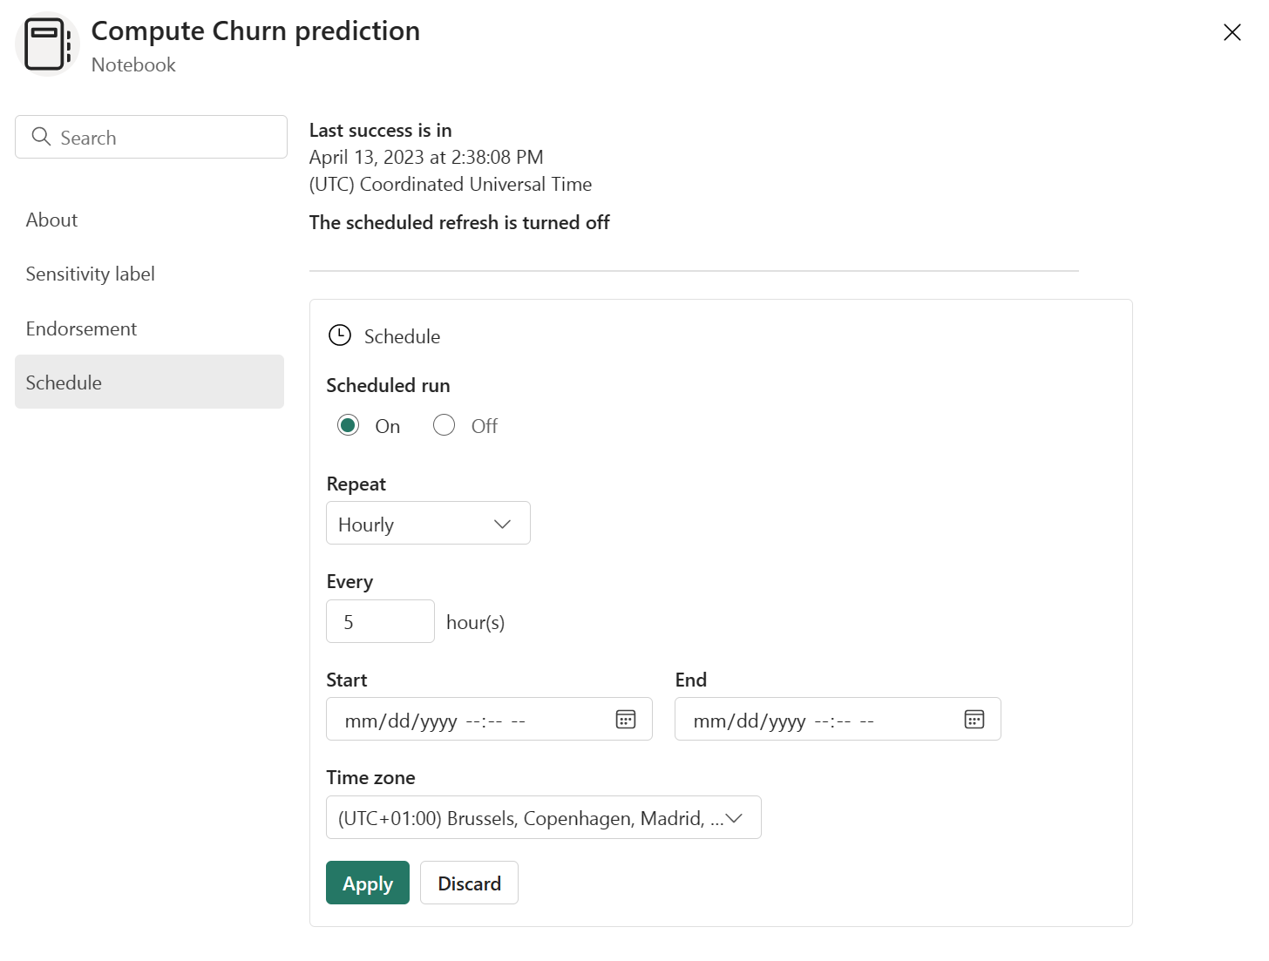
Schedule Notebooks

Slide 23
demo

Slide 24
data warehouse

Slide 25


Created in a workspace
Full T-SQL Commands
Synapse Data Warehouse
Several data ingestion methods
Automatically created with every LakeHouse
Read-only T-SQL Commands
SQL Endpoint
on the LakeHouse
Data ingested

Slide 26

this is not Synapse Dedicated SQL Pools

Slide 27
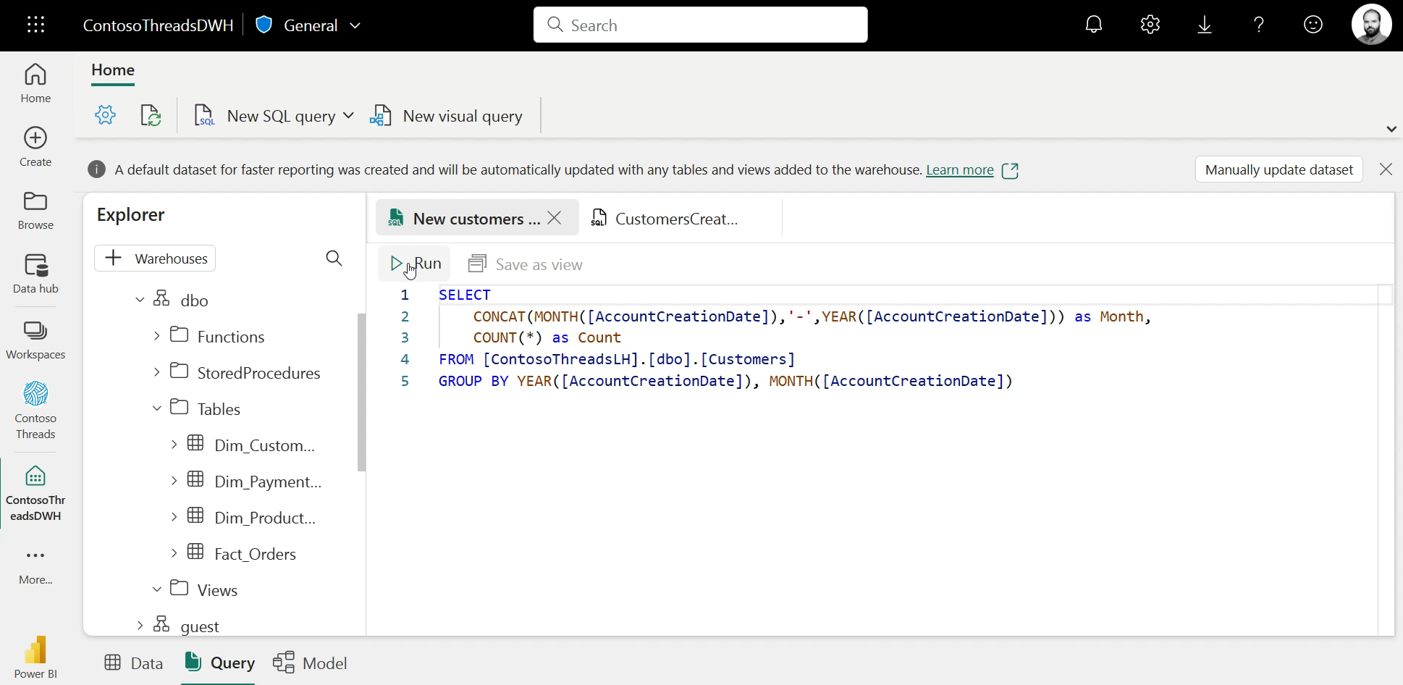
Build your warehouse
Notes:
Through the online editor, you can also execute simple SQL queries. These queries can be saved as view with just a click or saved as SQL code directly in the current workspace. This feature works for both types of warehouses. You can also create stored procedures that could be useful for querying or for some data ingestion cases.

Slide 28
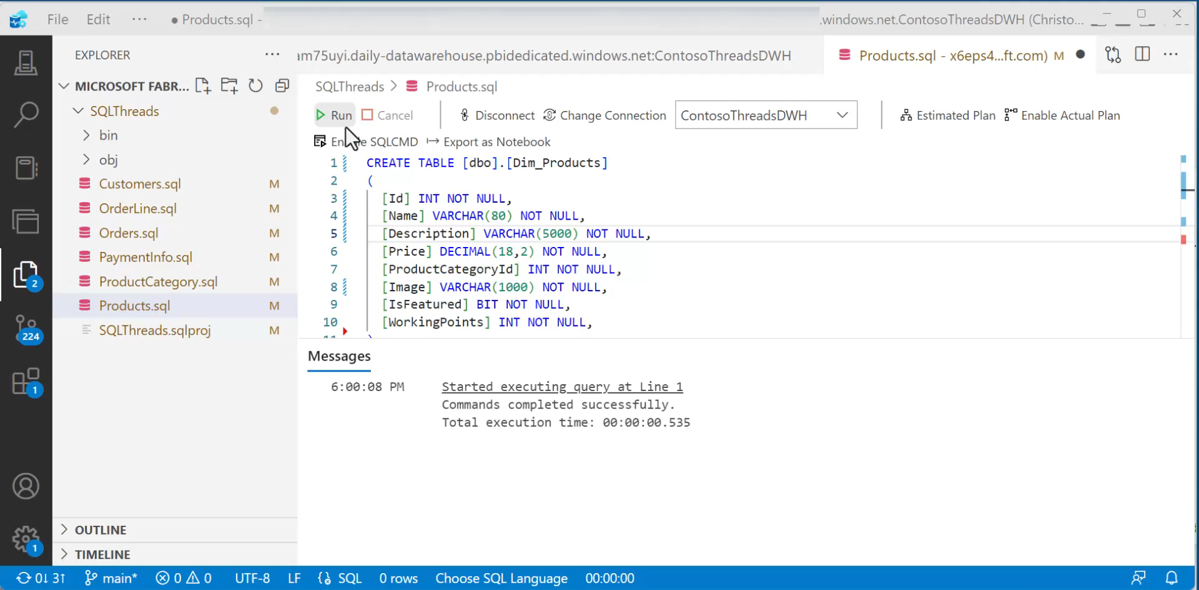

Slide 29
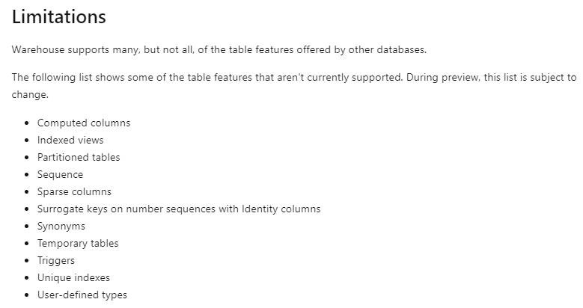

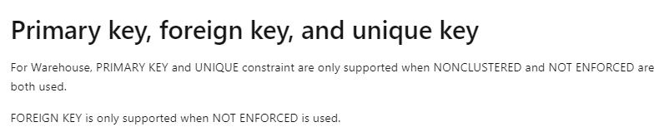
Notes:
surrogate keys are announced to be in the pipeline for Q1 2024

Slide 30
ingestion

Slide 31


Spark Job
Definitions
Data Flows
Notebooks
Data pipelines
Code-based pipelines
UI-based pipelines

Slide 32
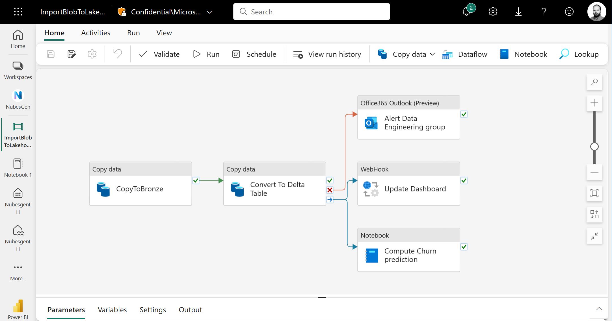

Slide 33
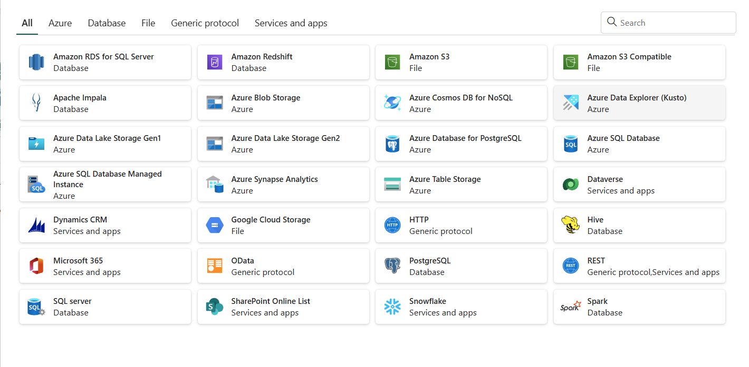

Slide 34
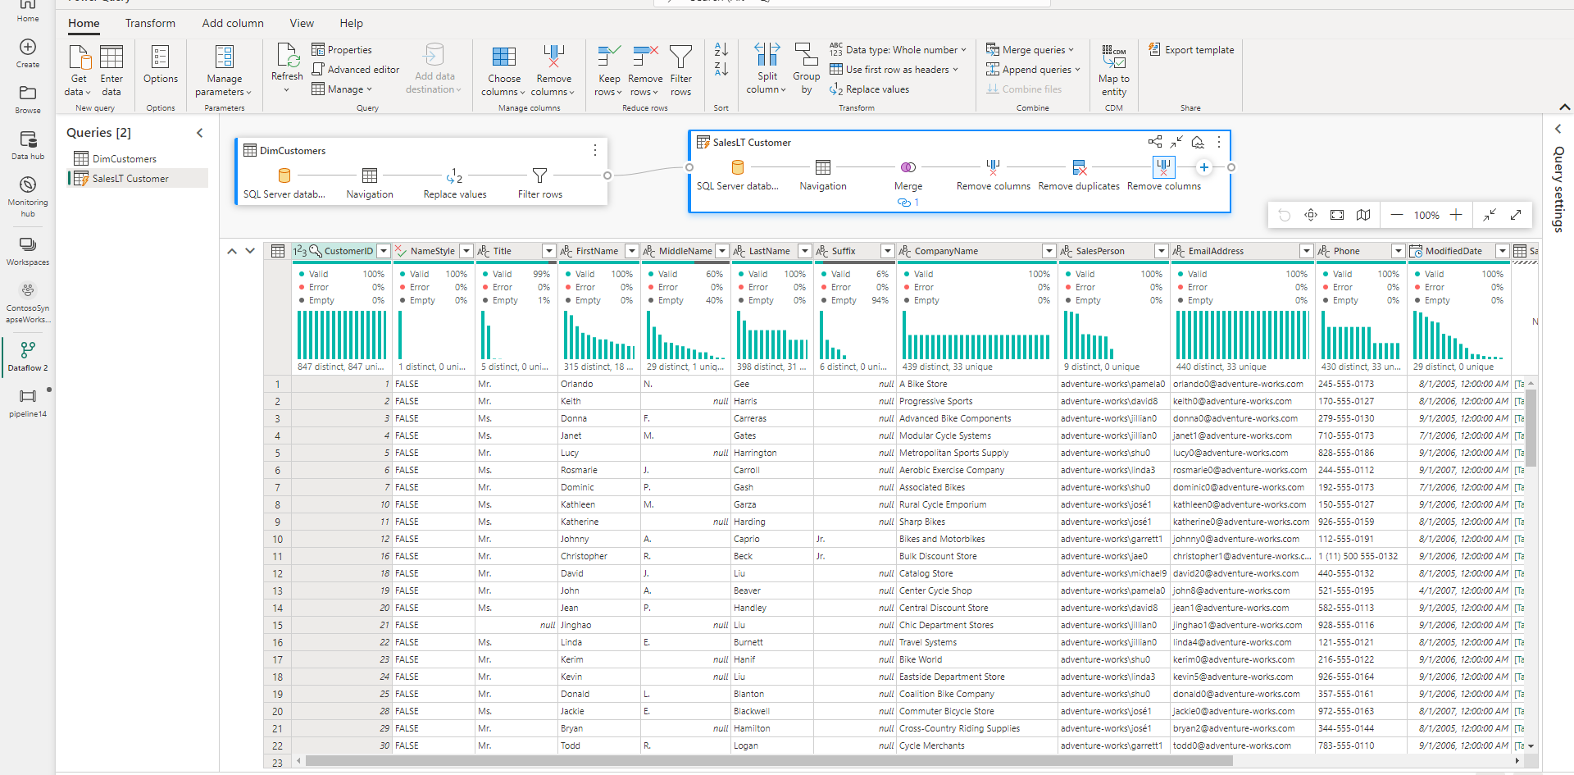

Slide 35
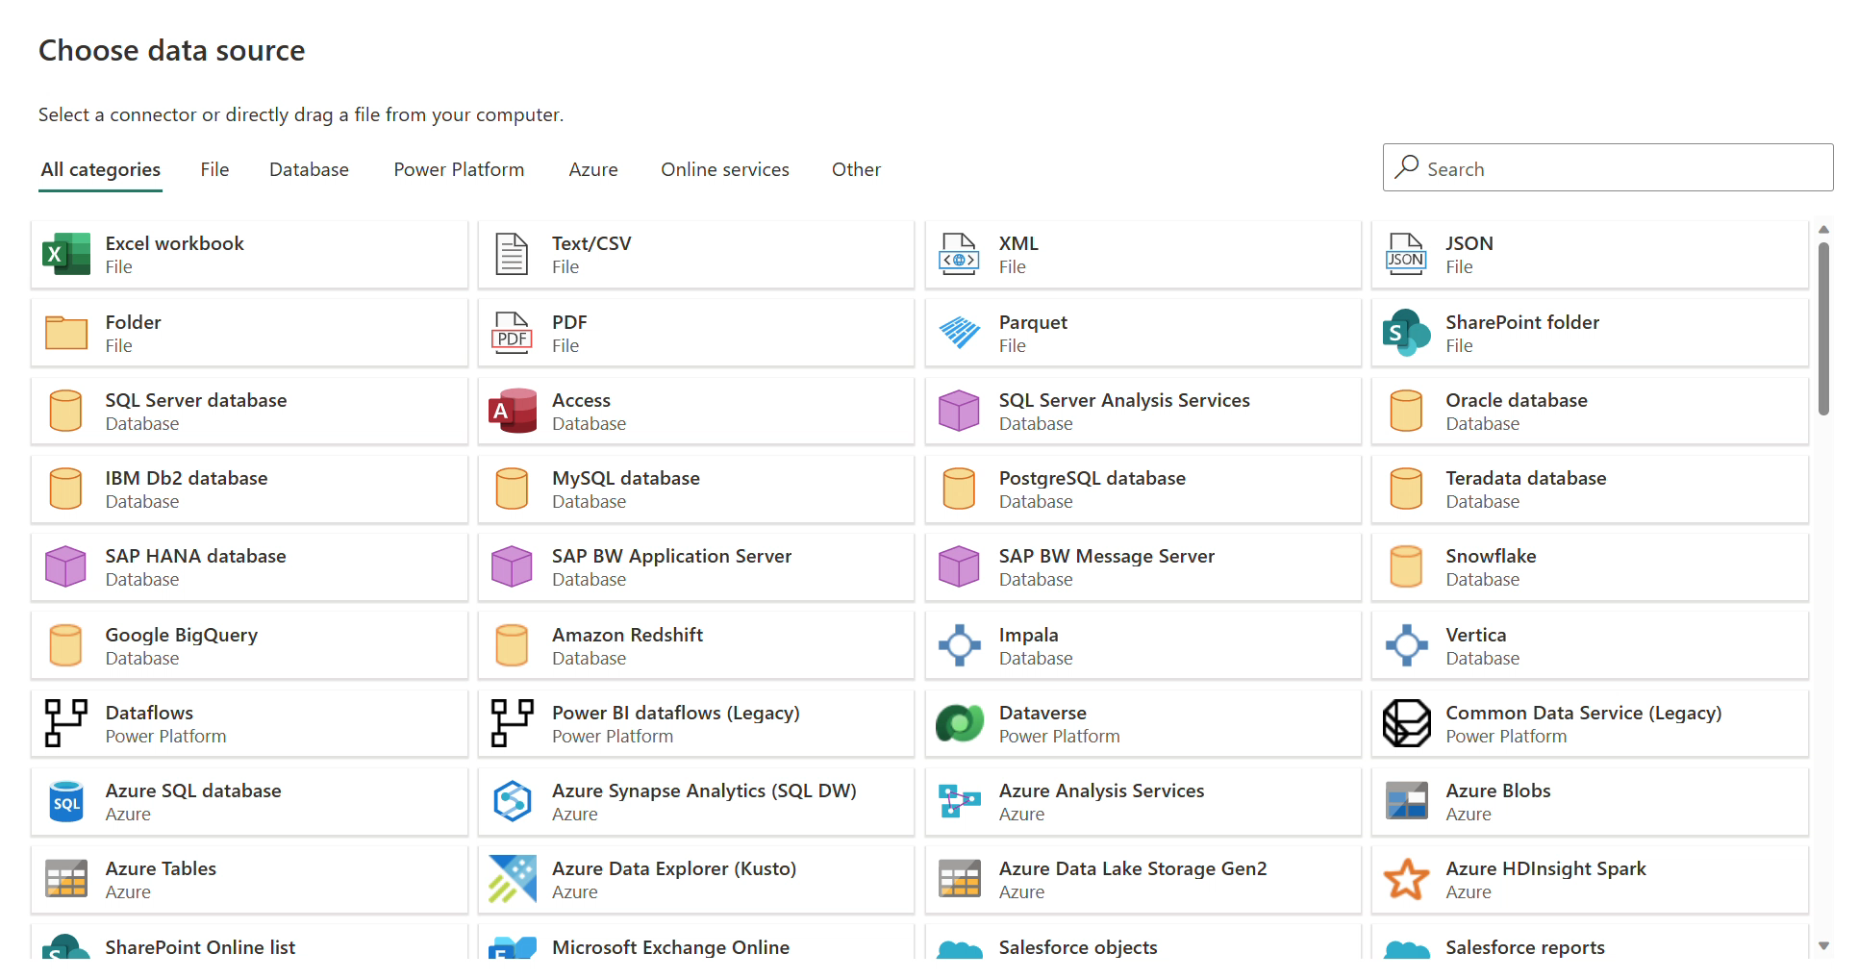

Slide 36
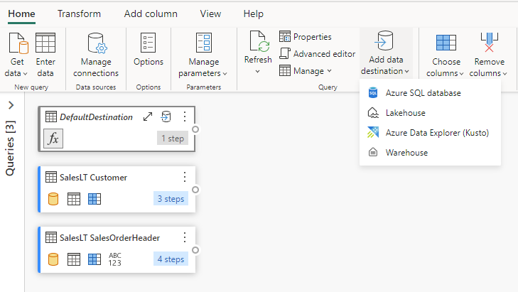
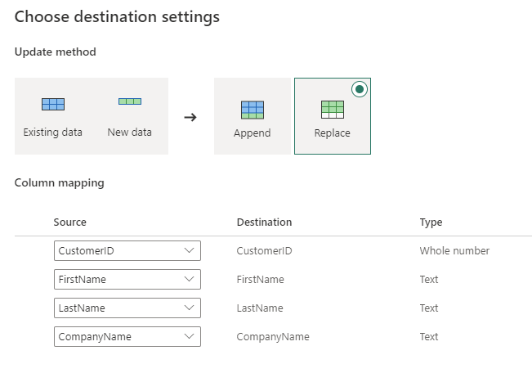

Slide 37
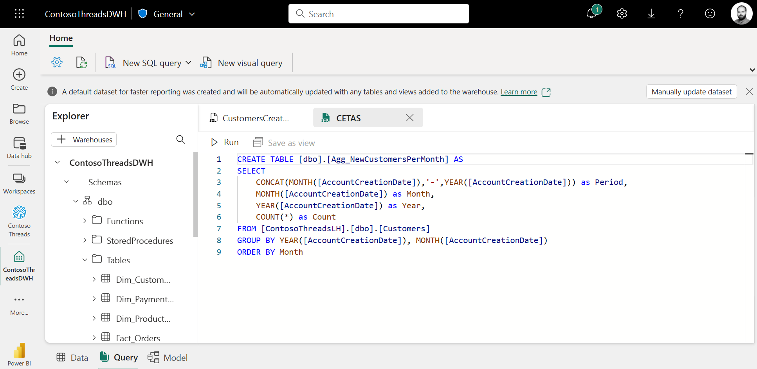
Notes:
or copy into

Slide 38
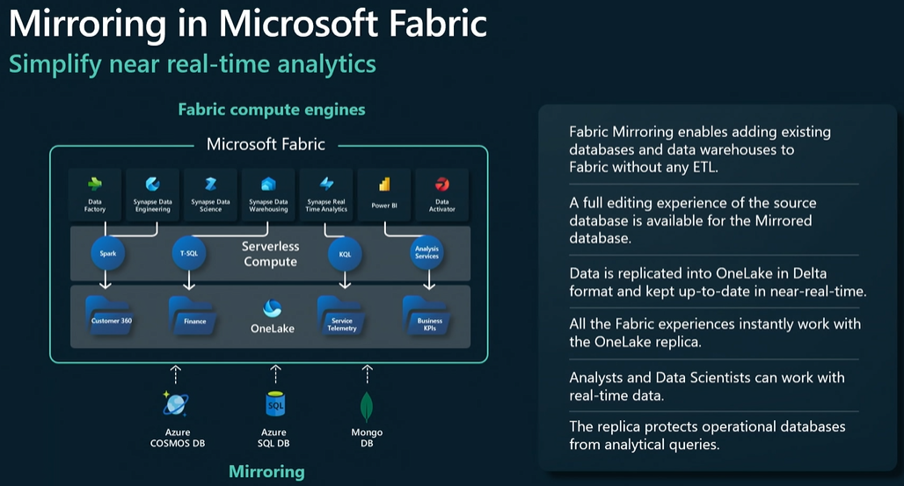
mirroring

Slide 39
data science

Slide 40
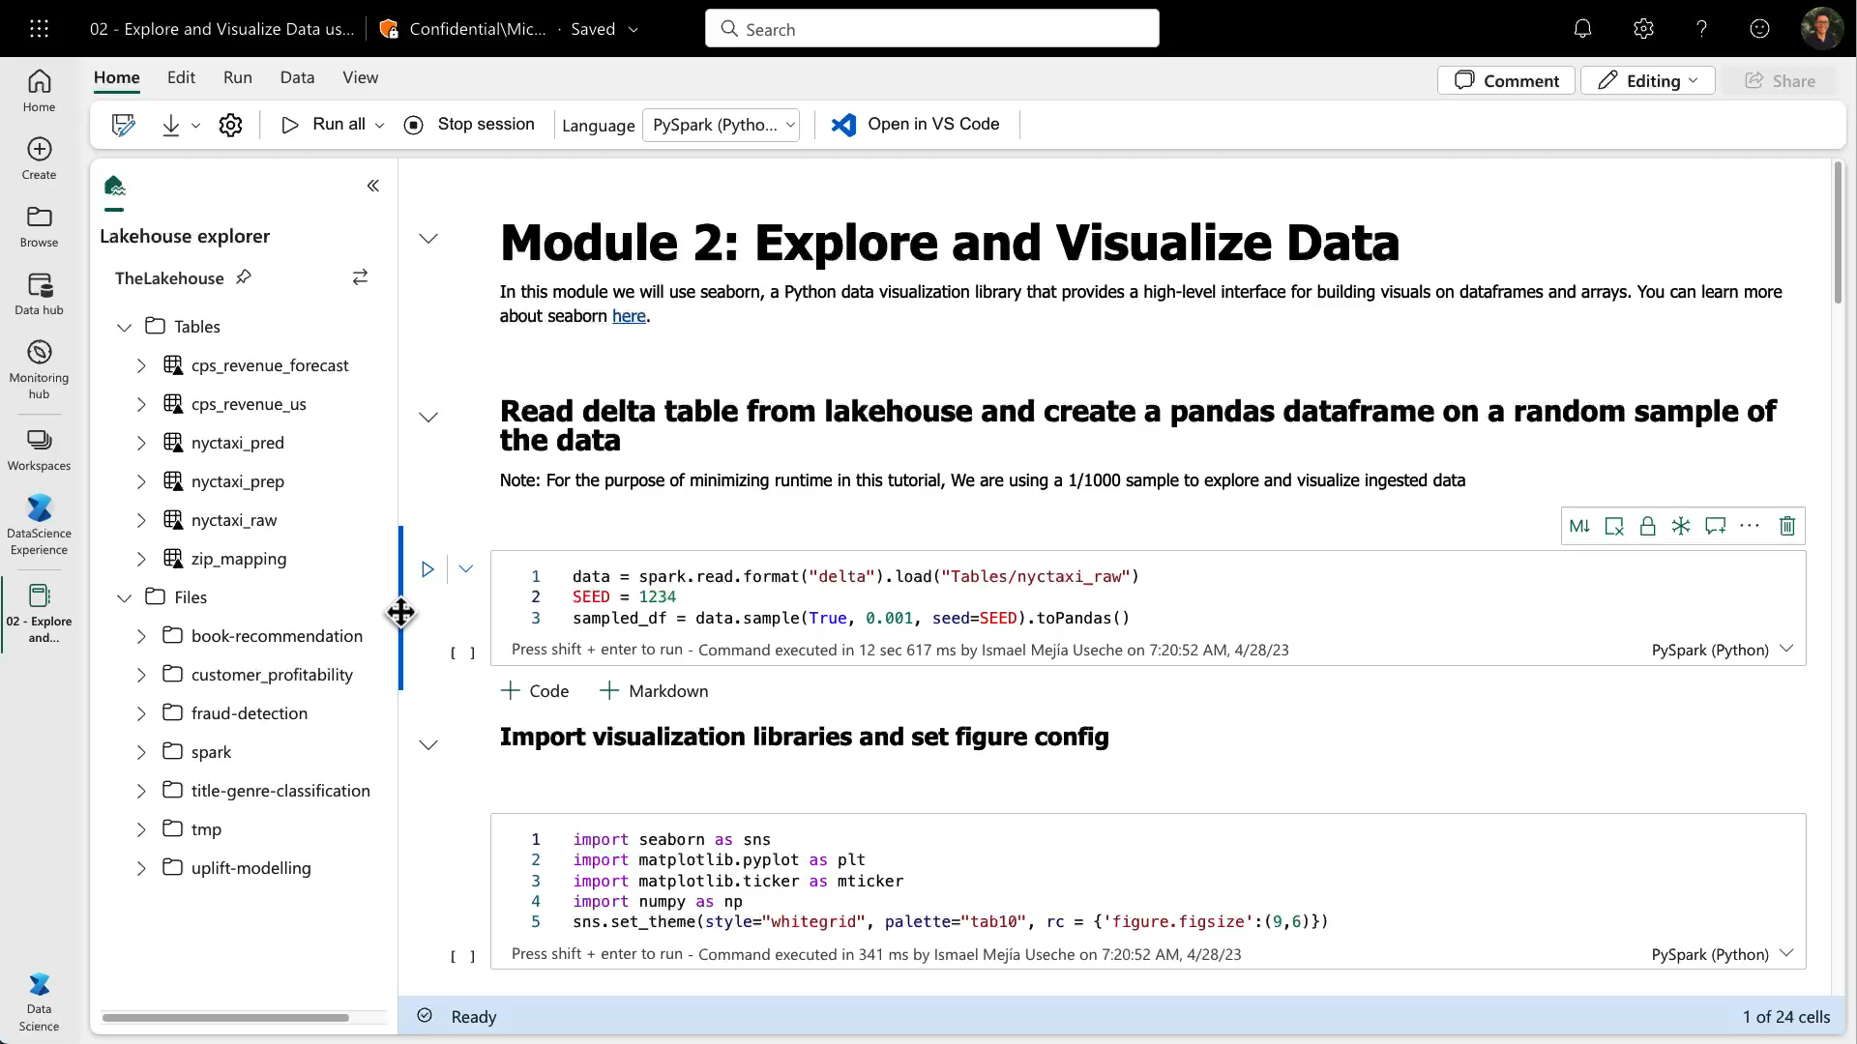
Notebooks

Slide 41
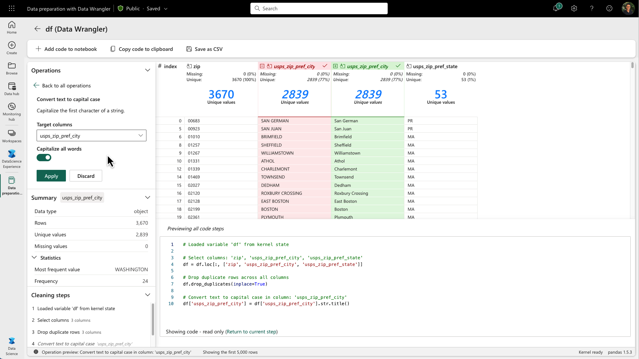
Data Wrangler

Slide 42


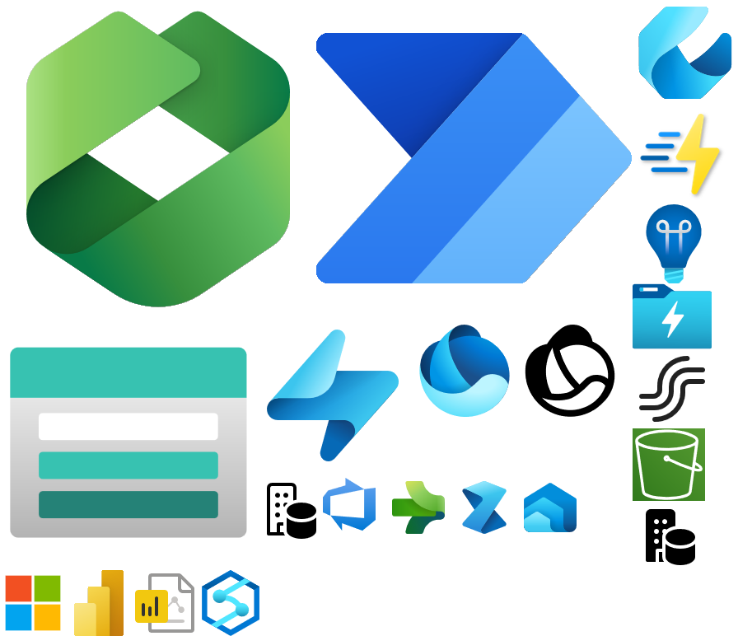



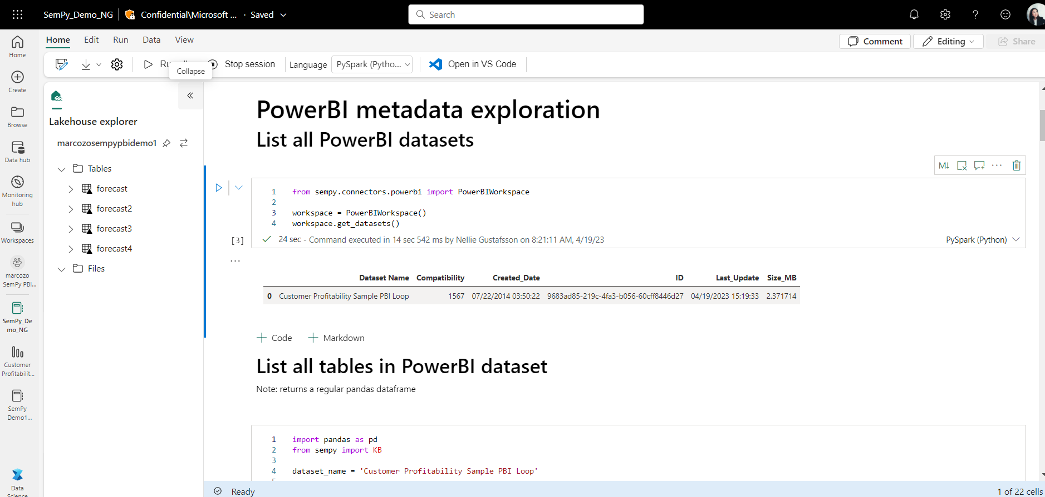
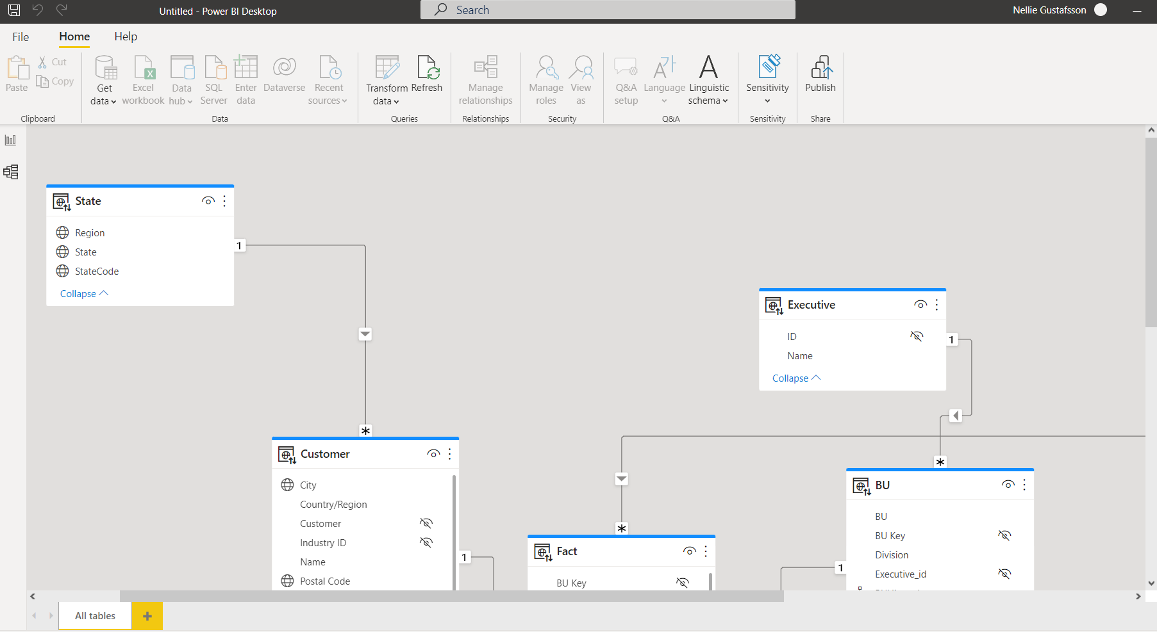

Semantic Link: Data Science and BI
Notebook
Notebook
PowerBI
Data Scientist
Data Analyst
Lakehouse

Slide 43



SynapseML and Microsoft AI services
Distributed ML Model Training
MLflow support
Cognitive Services
OpenAI LLMs
Notes:
SynapseML is an open-source Apache Spark library for machine learning. It enables Machine Learning at scale with distributed training of models and support for MLFlow.
SynapseML includes integrations with ready to use Machine learning services like Azure Cognitive Services for vision, speech, language processing and translation.
It also includes support for Azure OpenAI to enable access to large language models that are fine tuned and ready to use without any pain.
And of course Microsoft Fabric will also be powered by AI. One of the most exciting upcoming features is the copilot experience, which will leverage natural language processing support to do analytics and generate data preparation tasks on Notebooks.

Slide 44
real-time analytics

Slide 45

Paradigm shift in Data Consumption
Big Data Platforms
Terabytes of data
Low latency
High freshness
Streaming technologies
Index everything by default

Slide 46

Real-Time Analytics in Fabric - Reducing Complexity
Built on top off Azure Data Explorer
One Logical Copy
By-default streaming ingestion
By-default indexing everything
Time and Hash based data partitioning
Native support for structured, semi-structured and free text data
In-place transformation

Slide 47
Real-Time Analytics in Fabric - Simplifying
Tightly integrated with Fabric experiences
Mirroring to Lakehouse
By-default integration with event streaming sources
By-default integration with Power BI

Slide 48
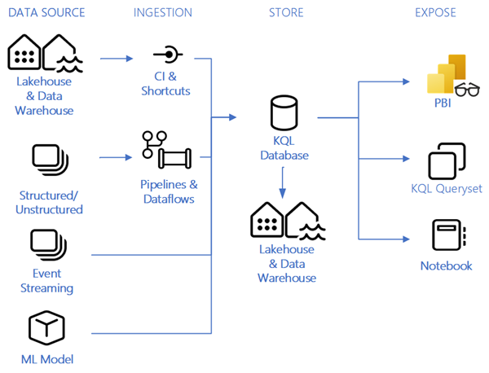

Slide 49
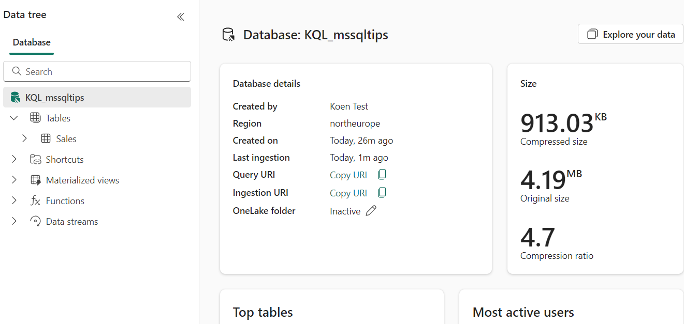
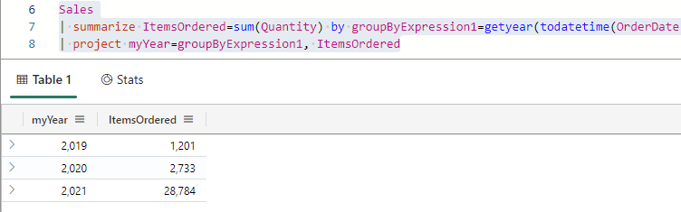

Slide 50
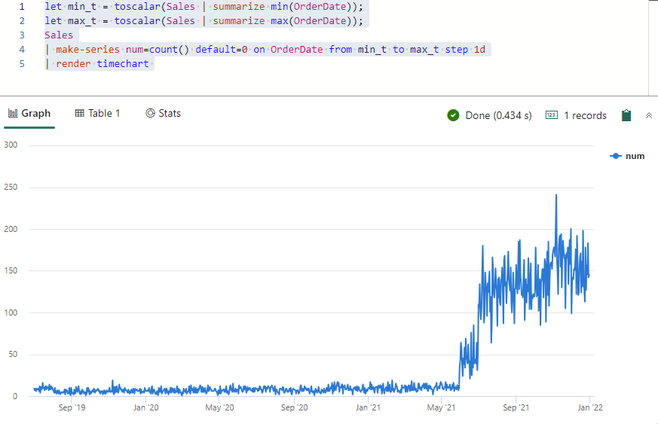

Slide 51
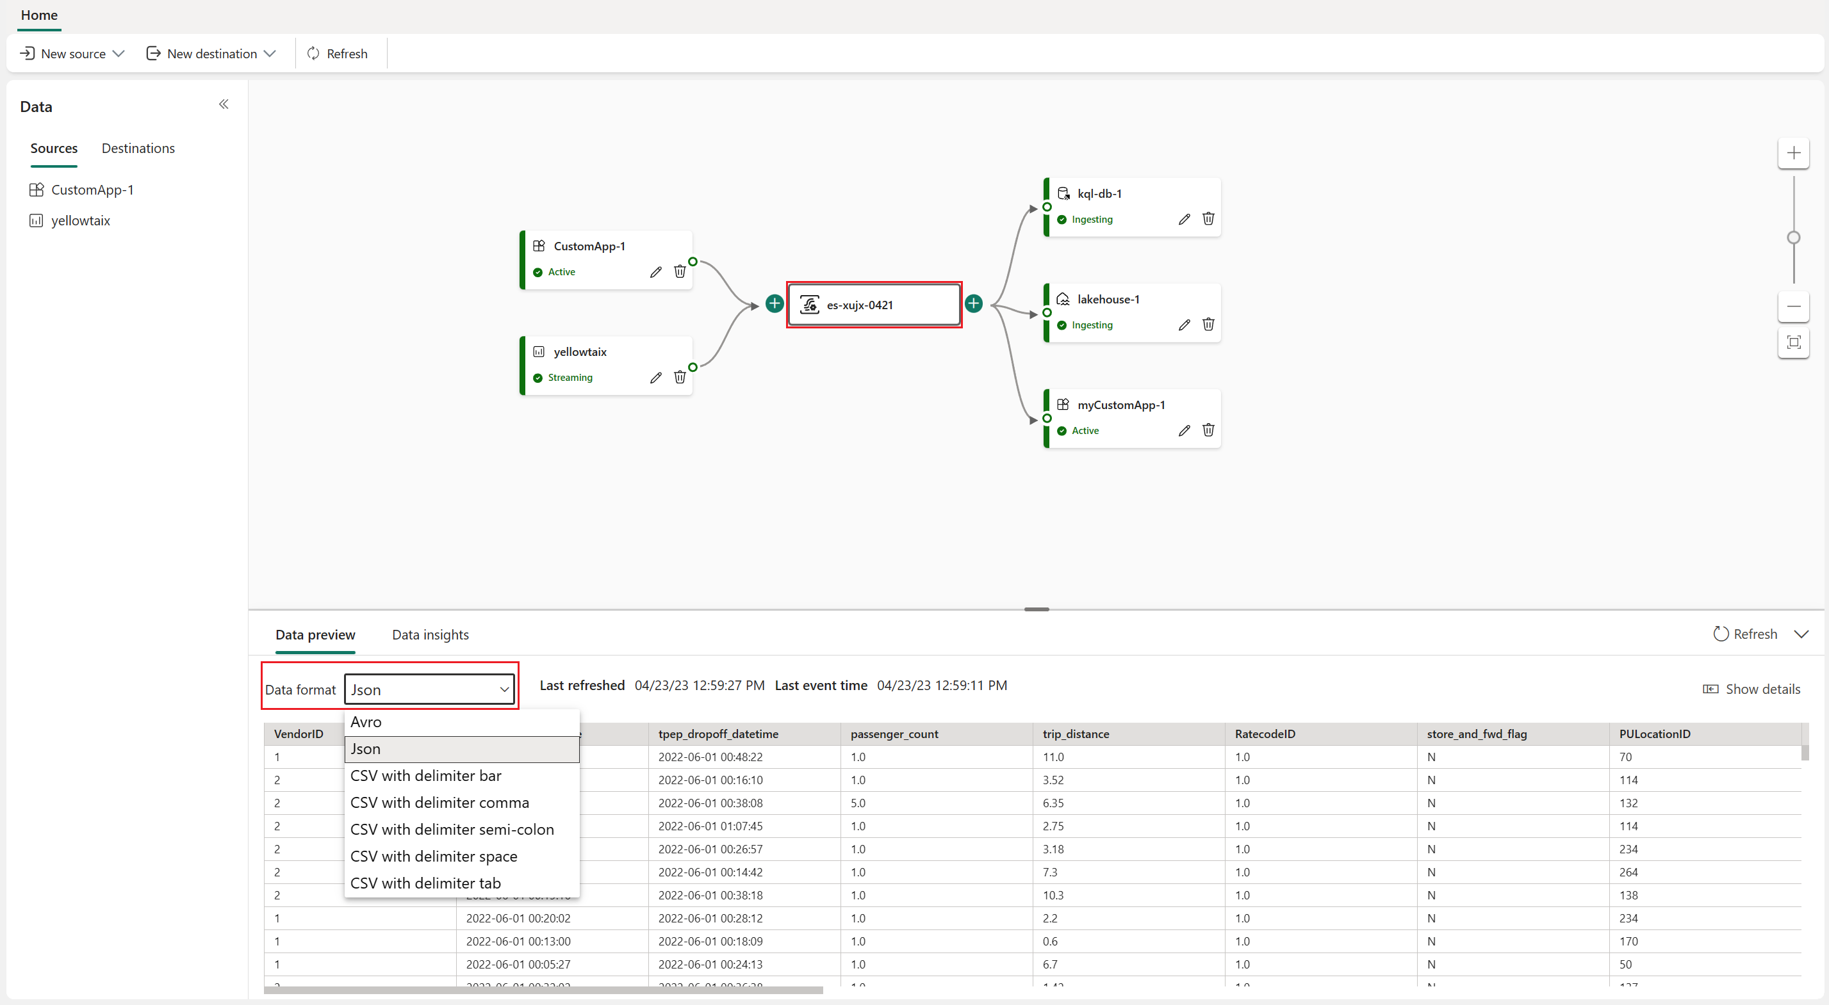

Slide 52
business intelligence

Slide 53
nothing changes for the average Power BI user

Slide 54
except…

Slide 55
“Direct Query Mode”
Parquet/Delta Lake
Data
Warehouse/
Lakehouse
Power BI
Analysis
Services
Scan
SQL
Queries
DAX
Queries
Tables
Reports
Slow, but real time
OneLake
“Import Mode”
Parquet/Delta Lake
Data
Warehouse/
Lakehouse
Power BI
Analysis
Services
DAX
Queries
Scan
Import
Latent & duplicative but fast
Tables
Reports
OneLake
Copy of
Tables

Slide 56
“Direct Query Mode”
Parquet/Delta Lake
Data
Warehouse/
Lakehouse
Power BI
Analysis
Services
Scan
SQL
Queries
DAX
Queries
Tables
Reports
Slow, but real time
OneLake
“Import Mode”
Parquet/Delta Lake
Data
Warehouse/
Lakehouse
Power BI
Analysis
Services
Scan
Import
DAX
Queries
Latent & duplicative but fast
Tables
Reports
OneLake
Copy of
Tables
“See-through Mode”
Parquet/Delta Lake
Data
Warehouse/
Lakehouse
Power BI
Analysis
Services
Scan
DAX
Queries
Perfect!
Tables
Reports
OneLake

Slide 57
data activator

Slide 58
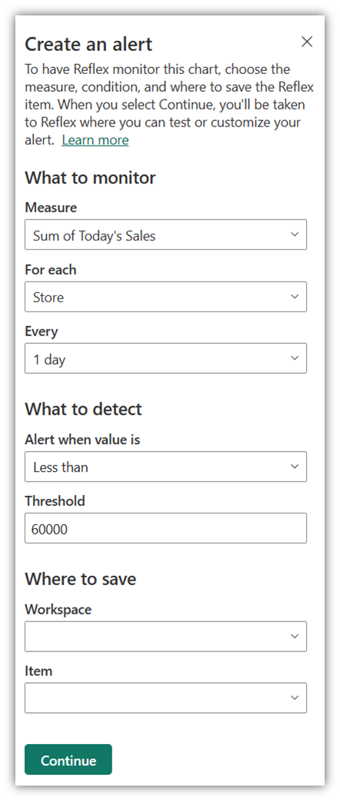
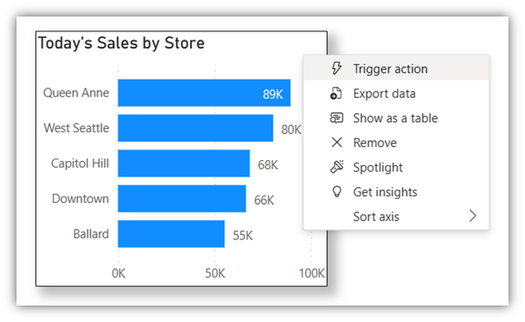

Slide 59
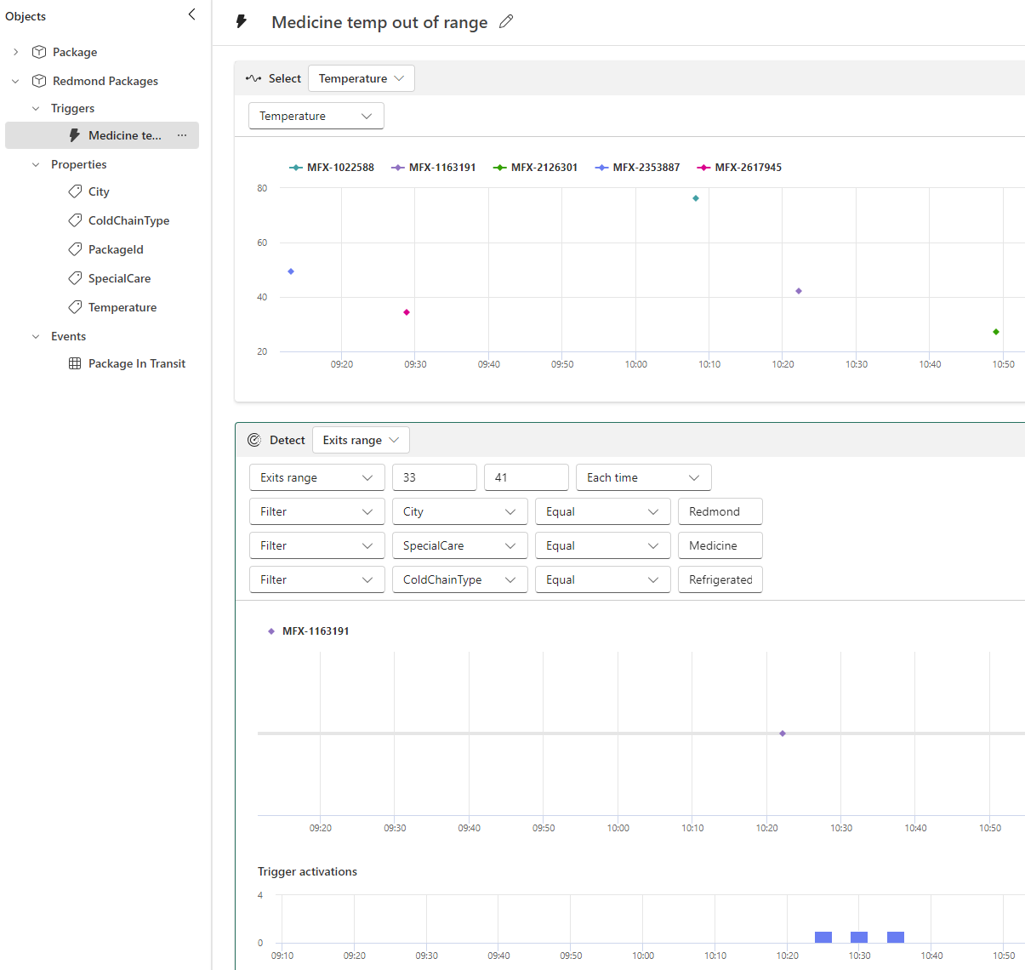

Slide 60
pricing

Slide 61

with Fabric the sky is the limit!
… as long as your wallet doesn’t have a limit

Slide 62
F SKU | P SKU | Pay-as-you-go (monthly) | Reserved Capacity P SKU (monthly)
F2 | - | $262.80 | -
F4 | - | $525.60 | -
F8 | EM | $1,051.20 | ~$750
F16 | EM2 | $2,102.40 | ~$1,500
F32 | EM3 | $4,204.80 | ~$3,000
F64 | P1 | $8,409.60 | ~$5,000-6,000
F128 | P2 | $16,819.20 | ~$10,000-12000
F256 | P3 | $33,638.40 | ~$20,000-24,000
F512 | P4 | $67,276.80 | ~$40,000
F1024 | P5 | $134,553.60 | ~$80,000
F2048 | - | $269,107.20
when below F64, every user needs Power BI Pro license
Azure SKU can be paused
can scale up or down
new: with F reserved capacity you get ~41% discount
basically Power BI Premium

Slide 63
conclusion

Slide 64

Data
Integration
Data
Engineering
Data Warehousing
Real
Time Analytics
Data Science
Business Intelligence
OneLake Storage
Finance
Customers 360
Service Telemetry
Business KPIs
Azure
Amazon
Google

Slide 65
is Fabric production ready?

Slide 66
… but it does have a lot of promise

Slide 67
resources
Get Started with Microsoft Fabric (free learning course)
What is Microsoft Fabric?
Microsoft Fabric Launch Event Day 1 and Day 2
Microsoft Fabric blog
Get Started documentation
Ignite Announcements:
Prepare your data for AI innovation with Microsoft Fabric—now generally available
Fabric workloads are now generally available!
Empower Power BI users with Microsoft Fabric and Copilot
Microsoft Fabric @ mssqltips.com

Slide 68
thank you

